Slide 1
An Holistic Approach to Cancer
Sarah Russell, FNP

Slide 2
Outline
What is cancer?
Why do we get cancer?
Why holistic?
Modern prevention/treatment
Root Cause analysis
First things first, the mental health side of it
Detoxification-metals, molds, microbes
IV treatments
Adjunct therapies
Food/nutrition
Fitness/fun

Slide 3
What is Cancer?
Your cells with your DNA
A body expressing a level of dysfunction (a symptom)
Mentally
In the gut
In the immune system
In nutritional status
In toxic load or ability to detox
Dysfunction in homeostasis
Abnormal cell duplication-damaged cells behaving abnormally with failure of the body to recognize and destroy them
A condition created by your body that your body can resolve, if given the right tools; A signal to you that your body needs healing
Communication disturbance in the signals cells use to communicate
A messenger bringing a strongly worded invitation to explore how your life may be out of balance. Then it is up to you to decide if you want to change it.

Slide 4
Why do we get cancer?
Physical/emotional/spiritual trauma
Unforgiveness or blocked mental/emotional healing
Genetic predispositions
Inadequate intake of nutrients that help the body heal
Excess exposure to toxin
Cancer increased exponentially with the Industrial Revolution
Poor lifestyle habits – especially smoking and excess alcohol use
Lack of healthy habits to fuel health in the body

Slide 5
Why holistic?
A hundred thousand biochemical reactions happening in the body every second in its one hundred trillion cells
Not fixing the root cause will only allow cancer or other disease to keep coming back
Not one problem but many
More than just –no cancer
We are not many parts detached but a whole composed of many parts
The body reacts as a whole

Slide 6
Modern Preventative Measures
Mammography: no difference in breast cancer death rate, leads to excessive unnecessary treatments/measures
Thermography: safe, effective in identifying risk areas, can scan the whole body,
Prefer Cologuard over colonoscopy
Cancerguard
PSA
blood test
Prostate Exams

Slide 7
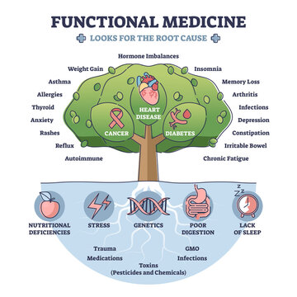
Root Cause analysis

Slide 8
Root Cause analysis-Mental Health
As a man thinks in his heart, so is he…
Who’s pressuring you? Who’s supporting you?
Do you want to Live?
What are you living for?
What keeps you from the healthiest version of yourself?
What stressors do you need to address?
Who do you need to forgive? Any bitterness/resentment?
Ask yourself the hard questions…
“Biology doesn’t work if you don’t deal with the psychology first…”
“Buried feelings never die..”

Slide 9
Root Cause analysis
Lab work
G6PD
CBC
CMP
CRP
ESR
Iron/tibc/fer
B3
Selenium
Zinc
Copper
Vitamin D
IL 6, 8
CEA
Thyroid/iodine (in anyone with thyroid hx.)
Hormone panel
Homocysteine
MTHFR (not needed if doing genetic testing)
Insulin
ANA w/reflex
Omegacheck
Cortisol
LDH
Alphagal/food allergy
PT/INR
CA 125, 19, 15,- cancer
markers for certain cancers
26.PSA (when applicable)
27. VEG-F
Follow up labs
  Any abnormalities from above
  Relevant tumor markers
  CBC, CMP, ESR, LDH, CRP
  ?Circulating tumor DNA
Natera
Exacta/Naturagene

Slide 10
Root Cause analysis - Toxins
Mycotoxins
Heavy Metals
Organic Acid Test
Comprehensive Stool analysis
Microbes
  Lyme, EBV, CMV, HPV, HIV, BLV, Hepatitis, Gut dysbiosis, parasites
Comprehensive Genetic Testing
Environmental
Drugs
  Opiod-based pain killers can stimulate cancer growth and spread
  Known carcinogens in medications/chemo/radiation

Slide 11
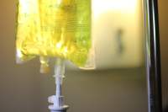
IV Therapies
IV Therapy
Detoxing
Individualized based on toxin testing
Chelation
Detox Ivs
Anti-parasitic (artemisinin)
Anti-fungal/mold
Antibacterial
Cancer specific
  Ozone therapy with UVB light therapy
    Similar healing benefits as HBOT, mild oxidative stress through reactive oxygen species (ROS) –stimulates immune system
    Floods cancer cells with oxygen, increases circulation to healthy cells, improves mitochondrial function
  Mistletoe aka Viscum/Hellaborus
    IV/SC heat therapy, inducing fever, cytotoxic to cancer cells, immune stimulating, aids in surveillance
  Curcumin, Quercetin, Melatonin, Resveratrol
  Artemisinin – increases ferroptosis, antiparasitic
  Vitamin C – 75-100g =toxic to cancer cells, produce ferroptosis, produce H2O2, starves cancer and causes cell death (helps rid cancer stem cells, reduces chemo toxicity)
    Used daily or 2-3 times a week

Slide 12
Adjunctive Therapies
Red Light Therapy,Hyperthermia, Rife
PEMF
Amethyst mat/grounding
Ozone insufflations
Foot detoxing
Fasting
Sauna

Slide 13
We Are What We Eat
Ketogenic
Plant Based
Clean, organic, grassfed meats
Healthy fats – avocados, coconut oil/fats, Olive oil
Lots of greens
Seafood –avoid fish high in heavy metals/plastics ie tuna, shrimp, anchovies, swordfish
AVOID DAIRY, Potatoes/sweet potatoes, beets, corn
Plant-based milks - unsweetened
Berries
GBOMBS
Eat the Rainbow
High fiber
Juicing
Eliminate processed/man-made foods
Overdose on Nutrition
Eat to Kill Cancer

Slide 14
Fitness
& Fun
Make Fitness fun
Ideal options: HIIT, racket sports
Seek Joy and have FUN

Slide 15
Supplements
Curcumin, Green tea, resveratrol enhance chemo and other cytotoxic therapies
Berberine/Metformin
Ginger
Boswelia
Quercetin
D3K2
Mushrooms
Ashwaghanda
Beta Glucan
DCA
Whole food supplementation
Amla
Soy
Melatonin
DIM
B17 (apricot seeds)
Coffee enemas
Parasitic detoxing
  Cellcore parasitic detox, mebendazole, fenbendazole, ivermectin

Slide 16
Other things to consider
Biologic Dentist
Netflix documentary – Zielinski
(Angie Lima’s Journey)
Hope4cancer.com
Hopeforbreastcancer.com
Chris Wark’s 20 questions to ask your
oncologist
Believebig.org
DNA testing - Genetic cancer markers
  ceGaT
  Nordic labs

Slide 17
Book Resources
540-613-1825
The Metabolic Approach to Cancer –Nasha Winters & Jess Kelley
- 10 Terrain Questionnaire
How to Starve Cancer –Jane McLelland
Mistletoe and the Emerging Future of Integrative Oncology – Steven Johnson & Nasha Winters
Hope for Cancer – Antonio Jimenez
Chris Beat Cancer & Beat Cancer Kitchen – Chris Wark
Exposing the Spiritual Roots of Disease & A More Excellent Way – Dr Henry Wright

Slide 18
Begging the question…
What can be changed most quickly
with the least amount of effort?
What causes the most damage?
What promotes the most healing?
What do you want?
What are you willing to do?

Slide 19
Your choices have the power to create health or disease in your body

Slide 20
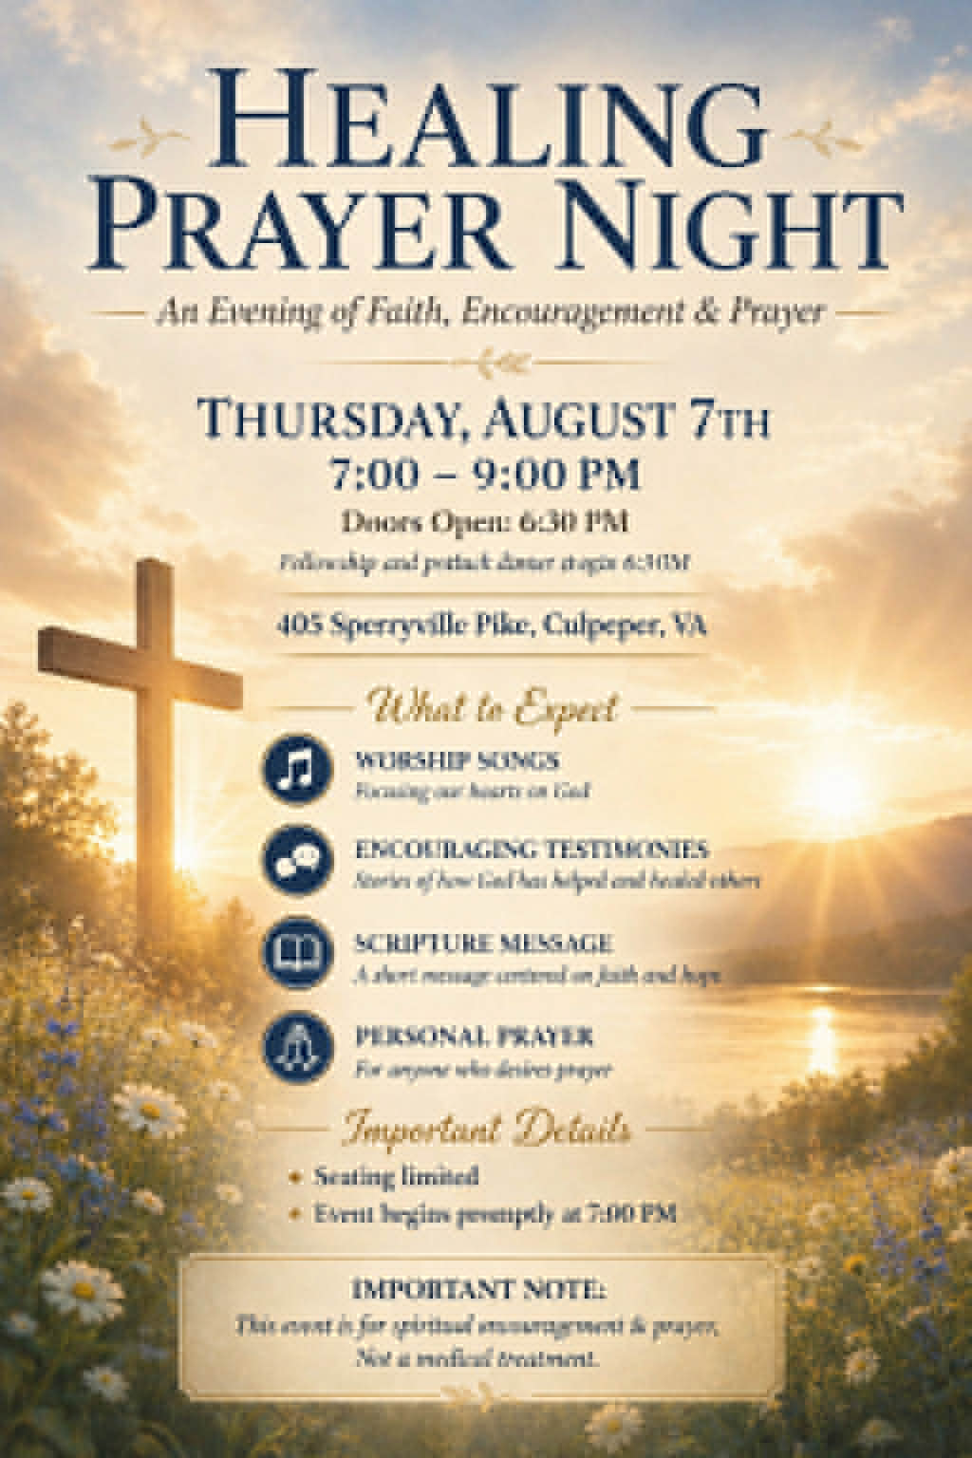
Friday
August 7th

